Slide 1
Develop a Small LSTM Recurrent Neural Network
Keras is an application programming interface or API. Keras makes use of TensorFlow's functions and abilities, but it streamlines the implementation of TensorFlow functions, making building a neural network much simpler and easier.
When it comes to implementing an LSTM in Keras, the process is similar to implementing other neural networks created with the sequential model.
For the text generation, we want our model to learn probabilities about what character will come next, when given a starting (random) character. We will then chain these probabilities together to create an output of many characters.
We need numpy to transform our input data into arrays our network can use, and we'll obviously be using several functions from Keras.
A neural network works with numbers, not text characters. So well need to convert the characters in our input to numbers.

Slide 2
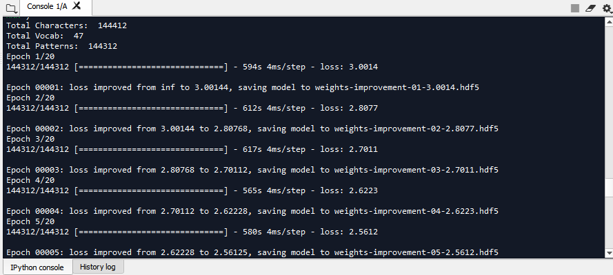
Output (Epoch 1-4)

Slide 3
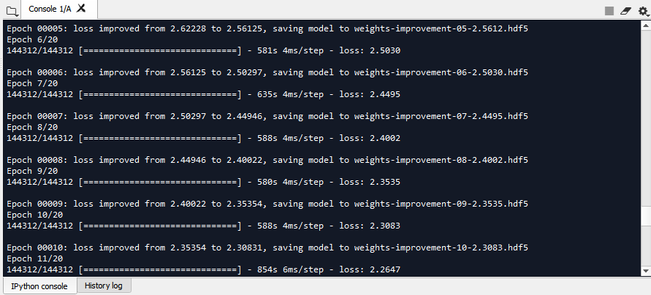
Output (Epoch 5-10)

Slide 4
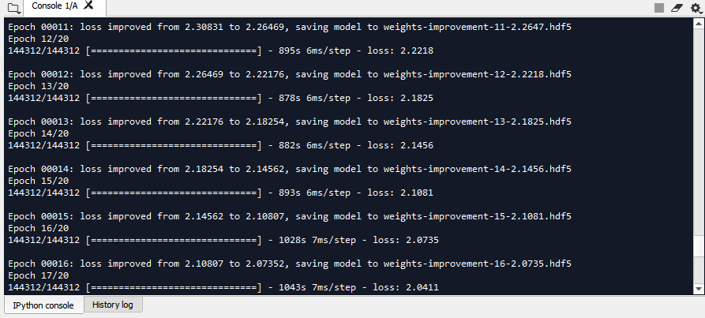
Output (Epoch 11-16)

Slide 5
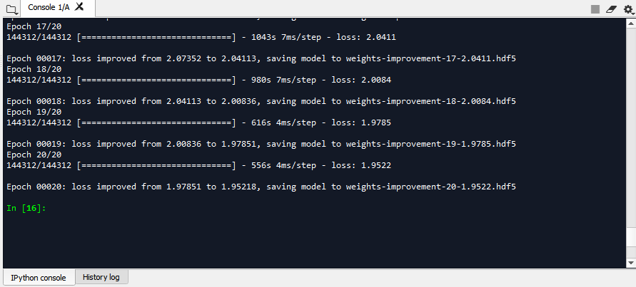
Output (Epoch 17-20)

Slide 6
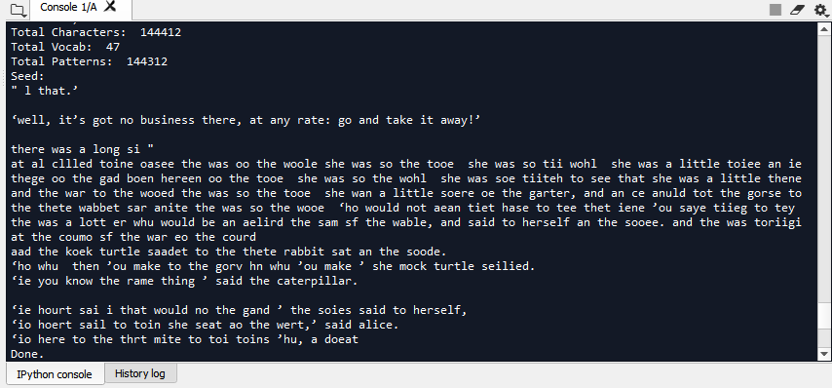
Output (Generated)

